Slide 1

MailX
Transform your email experience with MailX’s intelligence.

Slide 2

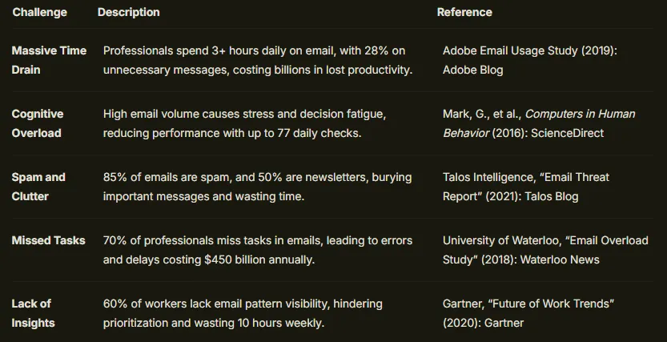
PROBLEM STATEMENT
UNDERSTANDING
Professionals face an overwhelming influx of emails, leading to information overload and cluttered inboxes. Manual sorting and triage make it difficult to identify critical messages.
SIGNIFICANCE
Inefficient email management results in missed opportunities, delayed responses, and reduced productivity. This challenge affects both individual workflows and team collaboration.
APPROACH TOWARDS THE PROBLEM
Our solution leverages a network of AI agents to automate email analysis, classification, and actionable response generation. This minimizes manual effort while ensuring timely processing.
CONTEXT OF THE PROBLEM
Traditional email systems lack the intelligence needed for real-time prioritization and context-aware actions. In today’s fast-paced digital landscape, an automated, intelligent solution is essential.

Slide 3


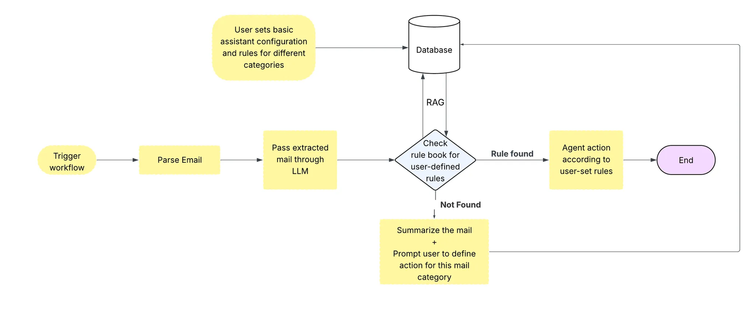

SOLUTION PROPOSED
MailX :
MailX is an AI-powered email assistant that streamlines inbox management. It classifies emails, extracts action items, categorizes them (e.g., meetings, approvals), summarizes content, and drafts quick replies. With spam filtering and Gmail integration, it keeps your inbox organized and efficient.
Work Flow Diagram

Slide 4
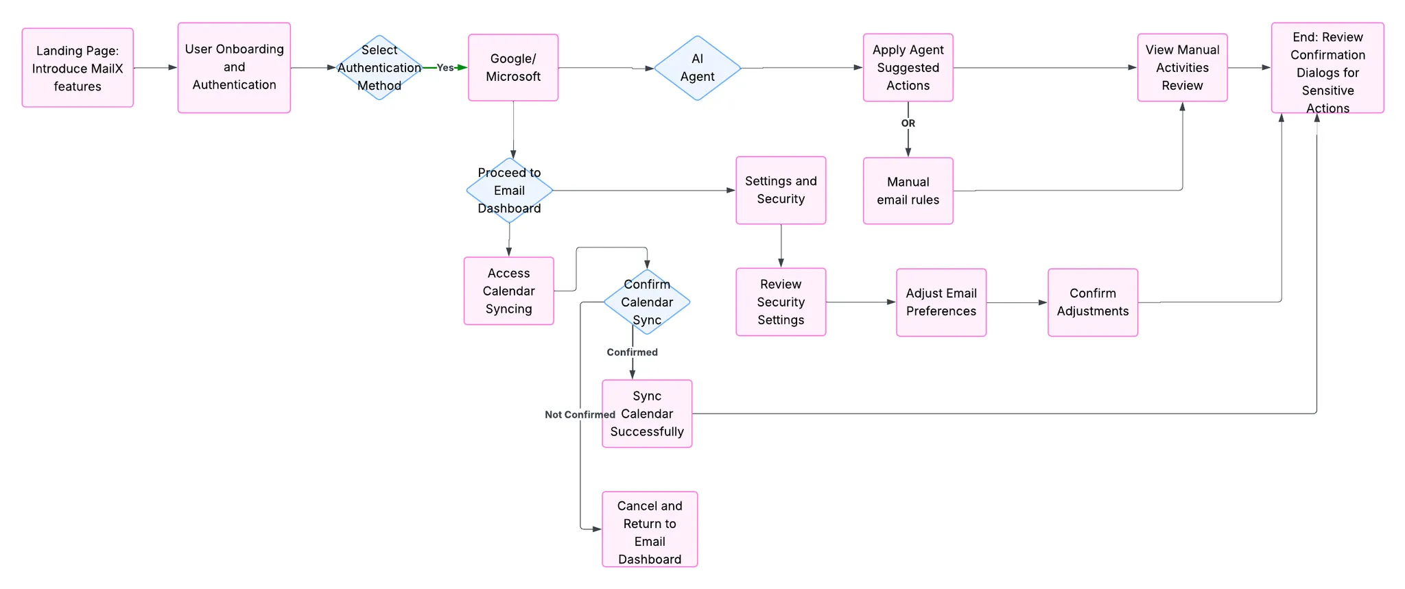
SOLUTION PROPOSED
UI Flow Diagram

Slide 5
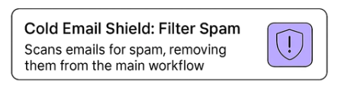
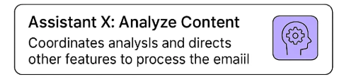
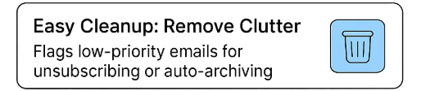
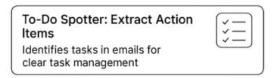

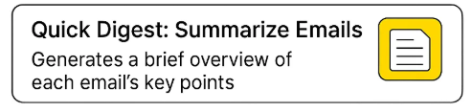
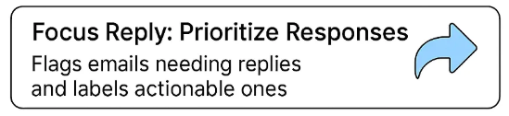
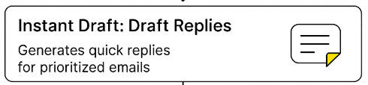
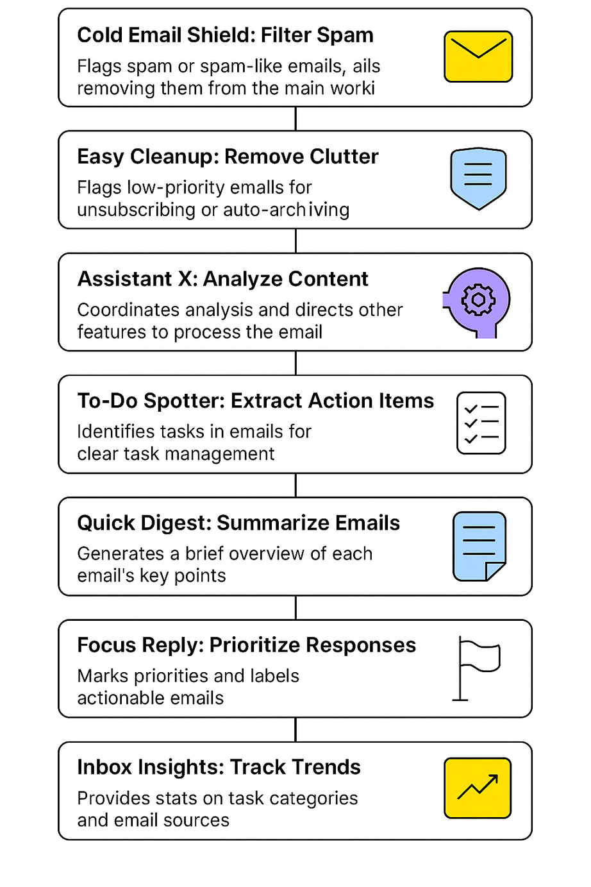
Features Of MailX

Slide 6
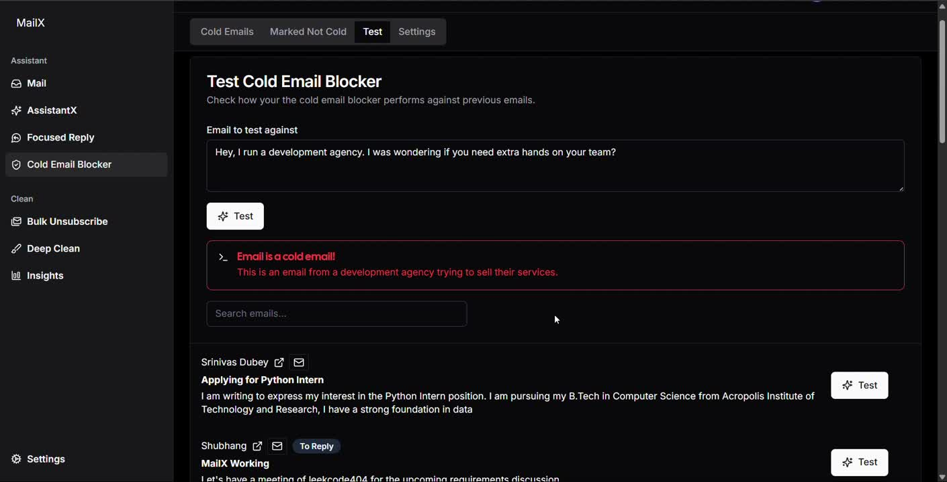
Cold Email Blocker

Slide 7
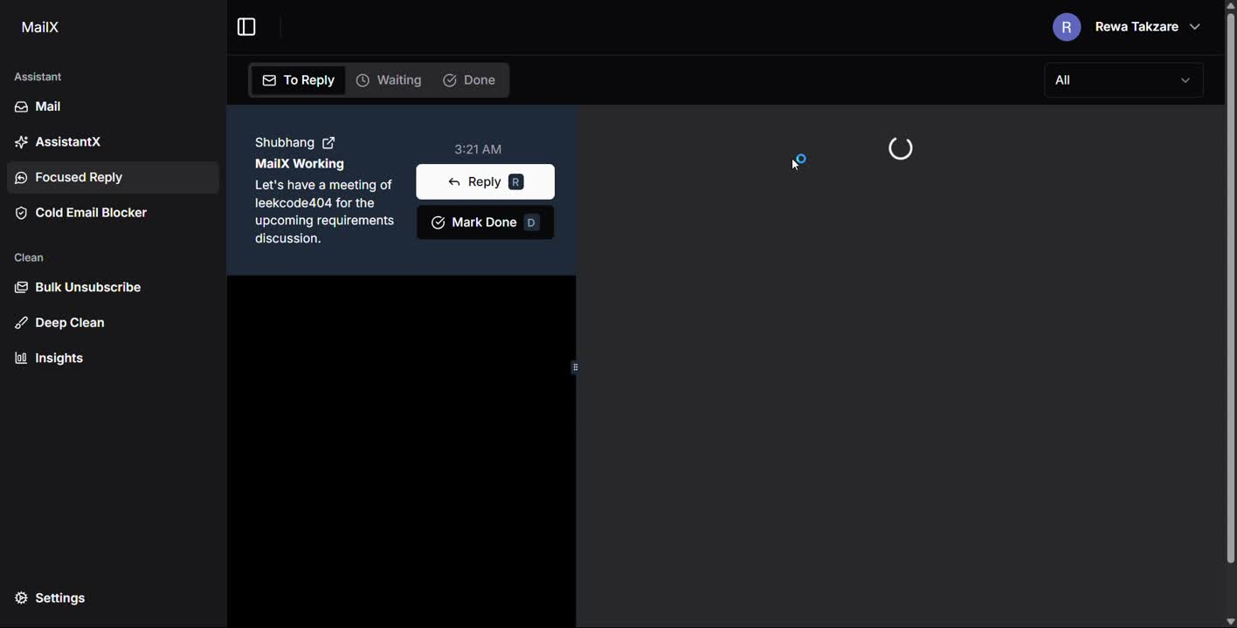
Focused Reply

Slide 8
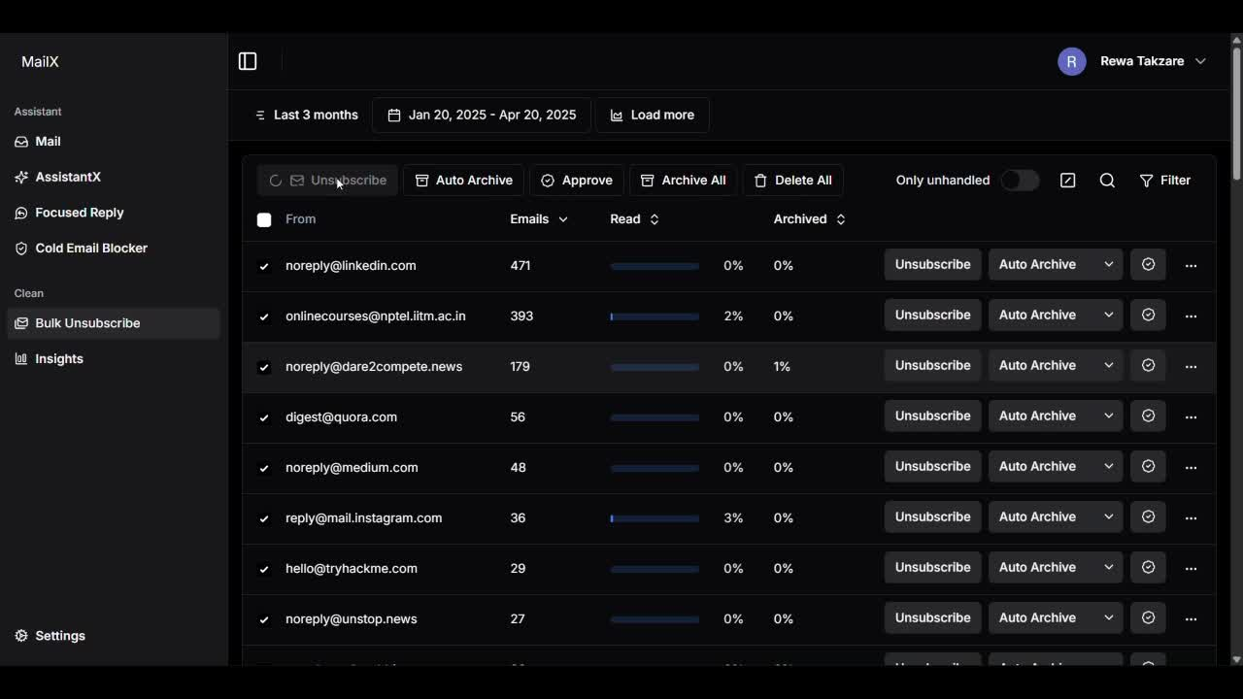
Bulk Unsubscribe

Slide 9
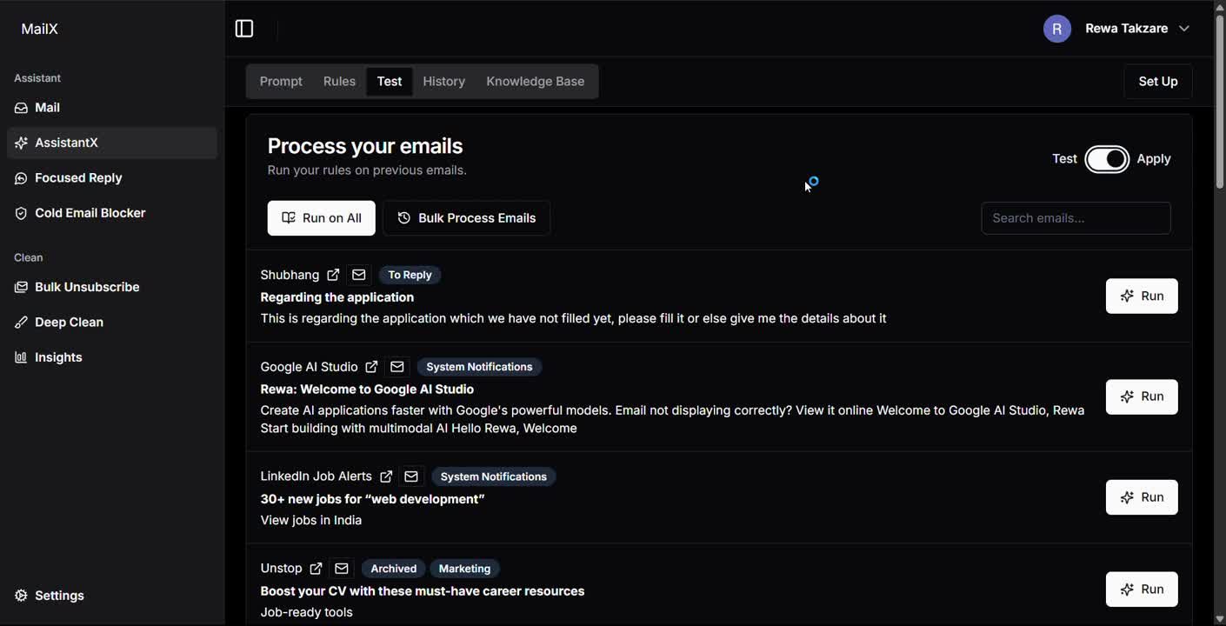
Assistant X

Slide 10
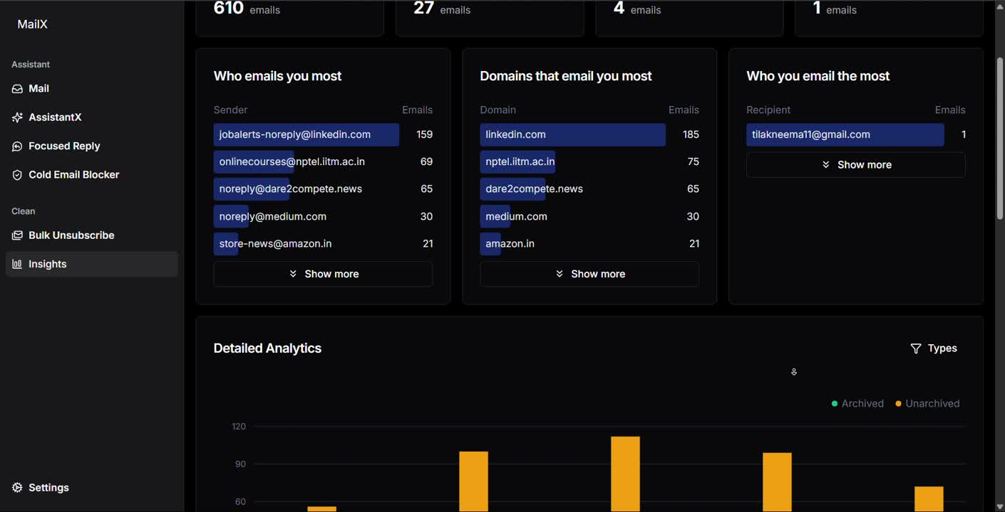
Inbox Insights

Slide 11
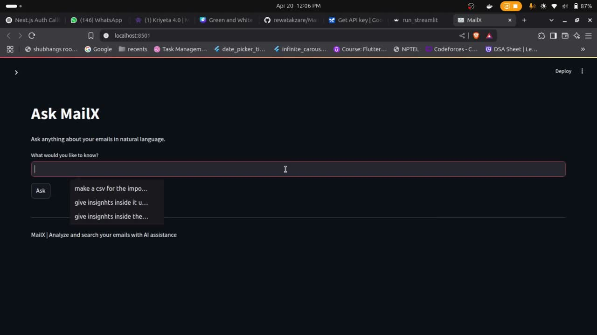
MailX Chat

Slide 12
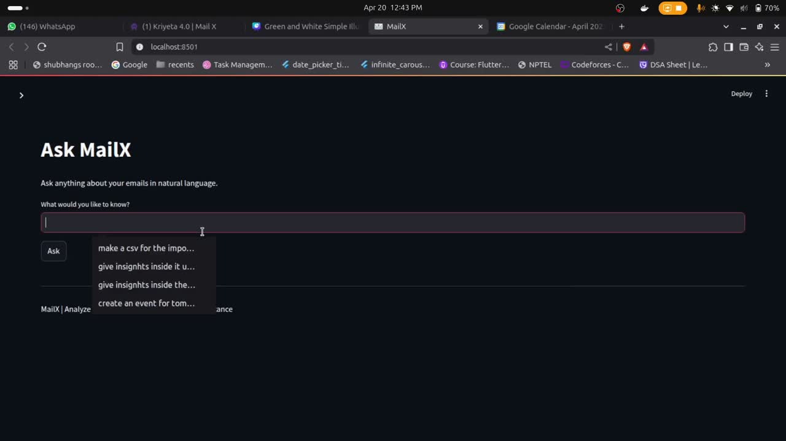
MailX Chat

Slide 13

Target Audience
MailX is built to streamline email management with AI-driven automation, task extraction, summarization, and reply drafting. Its features cater to people overwhelmed by emails, needing efficiency and organization.
Stake Holders | Pain Points Solved
Busy Professionals (e.g., Managers, Consultants, Freelancers) | Overloaded inboxes, missing deadlines, spending hours on email.
Executives and Team Leaders (e.g., CEOs, Directors) | Decision fatigue, cluttered inboxes, need for quick insights.
Administrative Staff (e.g., Executive Assistants, Office Managers) | Time spent sorting emails, managing multiple inboxes, repetitive replies.
Teams in High-Email Environments (e.g., Sales, Customer Support, HR) | Email overload, repetitive responses, tracking action items.

Slide 14
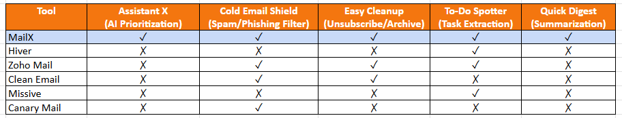
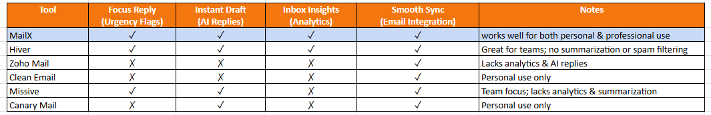

WHY CHOOSE US ?

Slide 15

Thank You

